Slide 1
Cancer genomics & precision medicine
Week 2, Computational Genomics

Slide 2
samples → variants → genes → cell types → processes → disease
What do we want to learn about in (cancer) genomics?
How do we find candidate genes that can cause cancer?
What are the implications for treating cancer if we have all of this genomics information?
Notes:
How do we have candidate cancer genes that cause cancer? How can do that computationally? Or from the wet lab? (Cancer genetics)
What are the implications for cancer therapy if we can find these candidate cancer genes?
What else?
Goal of the summer is to see how genomics can play a role in all parts of this pathway to understand a disease

Slide 3
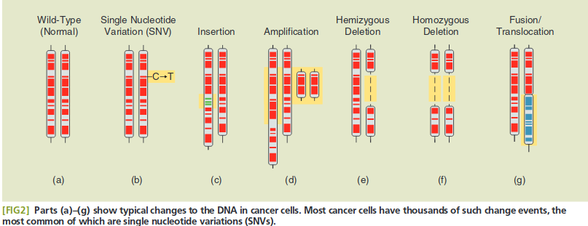
Common genetic alterations
Notes:
Let’s look at the types of mutations in more detail.
Synonymous mutations are not necessary silent mutations.
In the problem set, you also considered within SNVs:
"3'UTR" "5'Flank" "5'UTR" "De_novo_Start_OutOfFrame"
[6] "Frame_Shift_Del" "Frame_Shift_Ins" "IGR" "In_Frame_Del" "In_Frame_Ins"
[11] "Intron" "Missense_Mutation" "Nonsense_Mutation" "Nonstop_Mutation" "Silent"
[16] "Splice_Site" "Start_Codon_Del" "Start_Codon_Ins" "Start_Codon_SNP" "Stop_Codon_Del"
[21] "Stop_Codon_Ins"
Mechanisms
SNV (SNV vs. SNP - somatic vs germline)
Insertion - polymerase slippage at repetitive regions
Deletion - slippage, nuc flipping
CNV - template switching, non-allelic homologous recombination, non-homologous end joining, 1kb

Slide 4
Categorizing these alterations
What cell type? Germline vs. Somatic mutations
Does it have a function? Driver vs. Passenger mutation
What is its function? Oncogene vs. Tumor suppressor gene
Notes:
Driver mutation: a mutation that directly or indirectly confers a selective growth advantage to the cell in which it occurs. Missense mutations. (and: frameshifts, nonsense, etc.)
Passenger mutation: A mutation that has no direct or indirect effect on the select growth advantage of the cell. Could be silent/synonymous mutations.
Driver gene can contain both driver and passenger genes.
“A driver gene is one that contains driver gene mutations, but driver genes may also contain passenger gene mutations.” What does that mean?

Slide 5
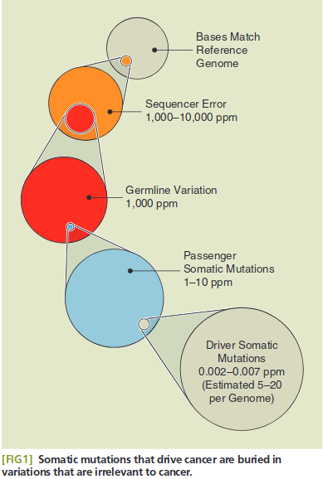
The driver gene is in the haystack
Notes:
Prevalence of mismatches to the reference genome
“Developing Algorithms to Discover Novel Cancer Genes”, Saksensa et al. (2012)

Slide 6
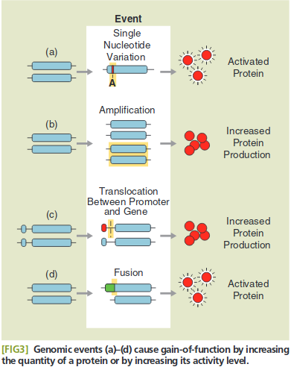
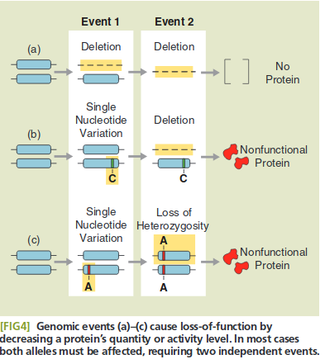
Oncogene vs. Tumor suppressor gene
Notes:
GoF - oncogene: a gene that when activated by mutation, increases selective growth advantage of the cell in which it resides.
SNV - KRAS GTPase function deactivated, leading to hyper active - (SNV vs. SNP - somatic vs germline)
Amplification - Myc targets important genes in cell cycle checkpoint
Translocation - Tumor viruses activate promoter of Myc
Fusion - Bcr-Abl - cell cycle and proliferation
LoF - tumor suppressor gene: a gene that, when inactivated by mutation, increases selective growth advantage of the cell where it resides. These genes tend to protect the cells from excessive growth or damage.
Deletion - TP53, VHL (turns off proteins for functioning in hypoxic states)

Slide 7
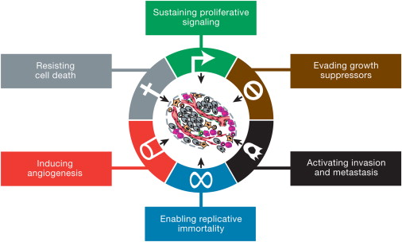
Notes:
This is Robert Weinberg’s illustration of themes in cancer:
Sustaining proliferative signaling - production of growth factors, overactivation of growth factor receptors, and dysregulation of proteins that give growth advantage: KRAS example. Myc example. Ability to generate their own mitogenic signals endogenously (autocrine)
Evading growth suppressors - Tumor suppressor genes are the guards against growth and encourages apoptosis. Rb binds to E2F, guarding the Restriction point for the S phase of the cell cycle.
Activation invasion and metastasis - Ability of cells to migrate - epithelial to mesenchymal transition, induced by TGF-beta. Loss of E-cadherin. CTCs. Increased PDL-1 expression to suppress the immune system.
Replicative immortality - changing the lifecycle of cells to continue cell division without going through crisis when telomeres shorten.
Sustained angiogenesis - increase in blood supply via recruitment of immune cells to generate growth factors such as VEGF that help create blood vessels. Epithelial - stromal interactions. Activation of pathways that cleave away ECM to help VEGF to stay.
Resisting cell death - loss of tp53, alteration of proteins that look for ds breaks, such as ATM. Mutations in apoptosis pathway.
Hallmarks of Cancer, Weinberg

Slide 8
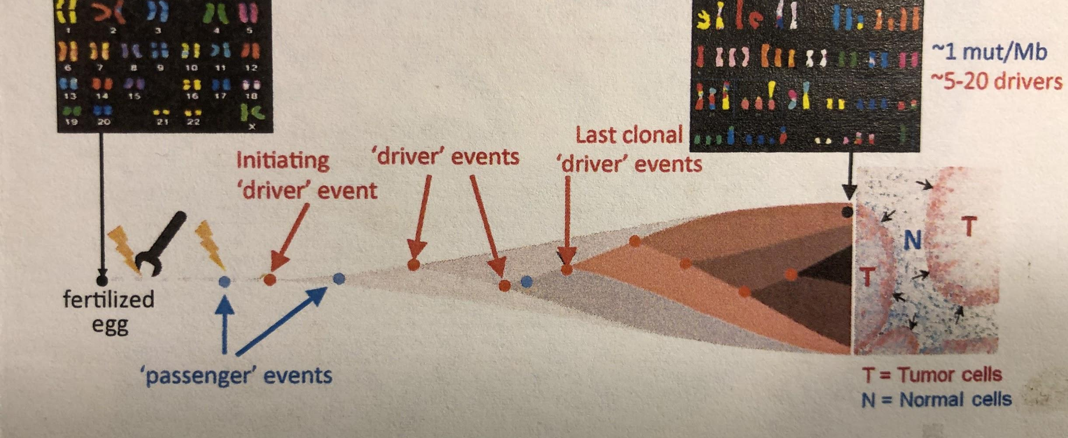
Cancer Etiology
Notes:
Etiology - the cause, set of causes, or manner of causation of a disease or condition.
Cancer is...a dysregulation of the cell circuit, leading to uncontrollable growth, breaking down the function of normal organs and tissues.
It is less about forming new circuits, but rewiring a few important one.
Genetically, this is through the accumulation of (mostly) somatic mutations. The somatic mutations that drive (or cause) cancer are by driver mutations, while passenger mutations sit along for the ride.
Probability of accumulating driver mutations increases over our lifespan. Hyperplastic, dysplastic, neoplastic cells. By the time a cancer neoplastic, they have x drivers. Metastasis.
Where do the mutations come from? Germline mutations, environmental factors (UV, smoking, radiation, viral infection), internal factors (chemical changes in the DNA, replication errors, mitosis or meiosis errors leading to nondisjunction)
Let’s look at the types of mutations in more detail.
“Critical Computational Challenges in Cancer Genomics” - Broad MIA Seminar, 2016

Slide 9
How do we find driver oncogenes or tumor suppressor genes? Cloning and sequencing using model systems, such as cell lines and mouse models...

Slide 10
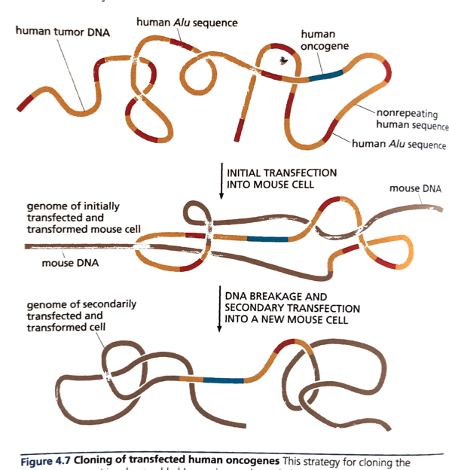
Notes:
The past way of finding driver genes:
Viral infections to find oncogenes: One can infect, look for cancer phenotype, then probe for the viral sequence to locate the oncogene.
Transfection experiments to put human tumor DNA in mice, then fish out the incorporated genome via human specific sequences, such as Alu repeats. Cut it, then reinfect. Repeat.
Genetic mapping of tumor suppressor genes using physical markers such as copy number decreases.
The new way of finding driver genes:
Sequence a population, find recurrent mutated genes.
We will look at patterns of mismatch back to the reference to tease out candidates for driver genes.

Slide 11
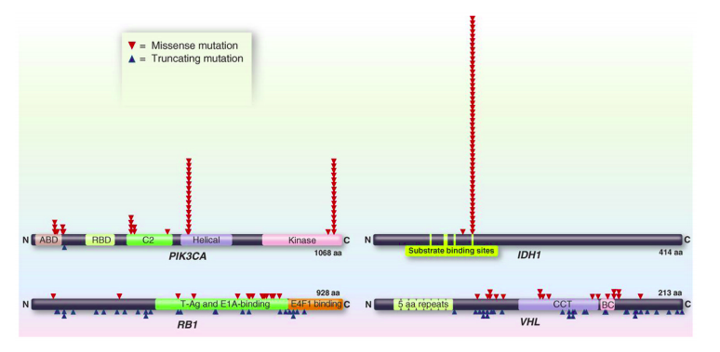
Notes:
Which one looks like an oncogene? Tumor suppressor gene?
20/20 rule for oncogenes: 20% of recorded mutations in the gene are recurrent and missense
20/20 rule for TSGs: 20% of recorded mutations in the gene are inactivating
Cancer Genome Landscapes, Vogelstein et al.
Connect to KRAS homework

Slide 12
So what?

Slide 13
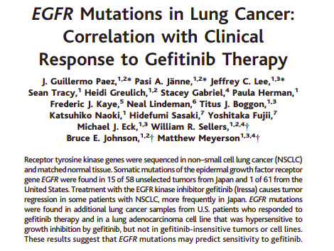
Notes:
So what?
Empirical methods of drug discovery for cancer were originally not mechanistic. People threw compounds at cell lines and see whether it decreased proliferation.
Gefitinib was a modest candidate to target epithelial growth factor receptor, showing moderate responses (10-20%), but using sequencing it was discovered that EGFR mutation at the kinase domain was strongly responsive to Gefitinib - Meyerson and Sellers paper.
Show first 12 minutes of Bill Sellers interview. 1:15 and to 14:00.
Understanding the genetic landscape leads to precision medicine. -- > our homework.
How would this study be done today in the modern sense? Associations of EGFR mutations in gefitnib in CCLE data.

Slide 14
What is precision medicine?
Prioritizing treatment using a patient’s genomic profile.
If patient has BCR-ABL in CML, use Gleevec.
If patient has EGFR in lung cancer, use gefitinib.
Notes:
Prioritizing treatment using a patient’s genomic profile.
If patient has Bcr-Abl in CML, use Gleevec
If patient has EGFR in lung cancer, use gefitinib.
CCLE enables this, because one can get drug sensitivity data from cell lines also.
So if a cancer subtype is sensitive to a drug, we can figure out what common genomics features there is:
To show that the drug works on its supposed target
Why does this drug work? (chemo, X-ray)
Prioritizing ~ stratisfying

